Slide 1



Department of Information Technology
Final Year Project
Batch No: 4
Project Phase I
SPATIO-TEMPORAL ATTENTION MECHANISM ON MRI SLICE SEQUENCES FOR MULTIPLE SCLEROSIS DIAGNOSIS
TEAM MEMBERS :
Guide name:
Mrs. J MANJU, M.E
Assistant Professor
Abinash A
Monish V
Charukesh M
Mohammed Raashid S
- 113123UG07001
- 113123UG07072
- 113123UG07017
- 113123UG07069

Slide 2

INTRODUCTION
Multiple Sclerosis (MS) is an autoimmune disease that affects the central nervous system, specifically the brain and spinal cord.
In MS, the protective covering surrounding nerve fibres, known as myelin, becomes damaged.
This damage disrupts how nerve signals travel, which can lead to a wide range of neurological symptoms.
Doctors often use MRI scans to look for signs of MS, as these scans can show areas of damage (lesions or abnormalities) in the brain and spinal cord.

Slide 3
PROBLEM STATEMENT
Problem Identification
A patient's brain MRI scan consists of many sequential slices.
Many existing 2D CNN methods treat each slice as an independent image.
This can lead to loss of important information that exists between consecutive slices.
3D CNN methods capture the full volume, but at the cost of increased memory and computational demands.
Incorrectly splitting or shuffling slices during training can cause patient-level data leakage, rendering evaluation unreliable.

Slide 4
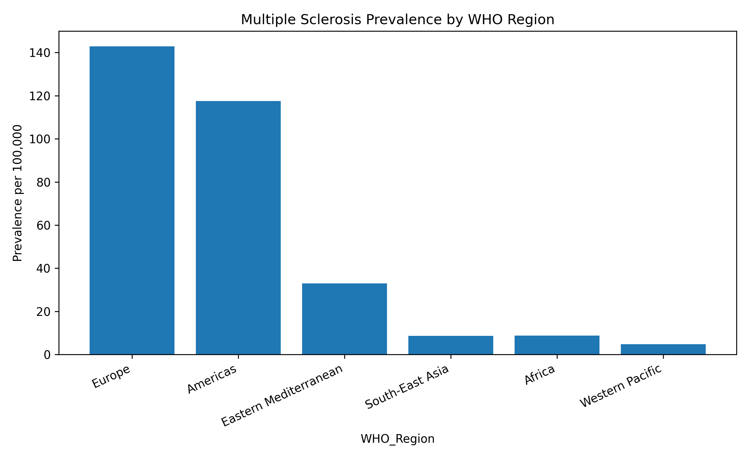
Review and Status of Research
International Status
MS is a chronic autoimmune disease that affects the central nervous system.
In 2023, 2.9 million people were living with MS worldwide.
The number rose from 2.3 million in 2013 to 2.9 million in 2023.
MS prevalence is higher in women than men, specifically in patients with relapsing forms of the disease.
Sources: Atlas of MS / MSIF.

Slide 5
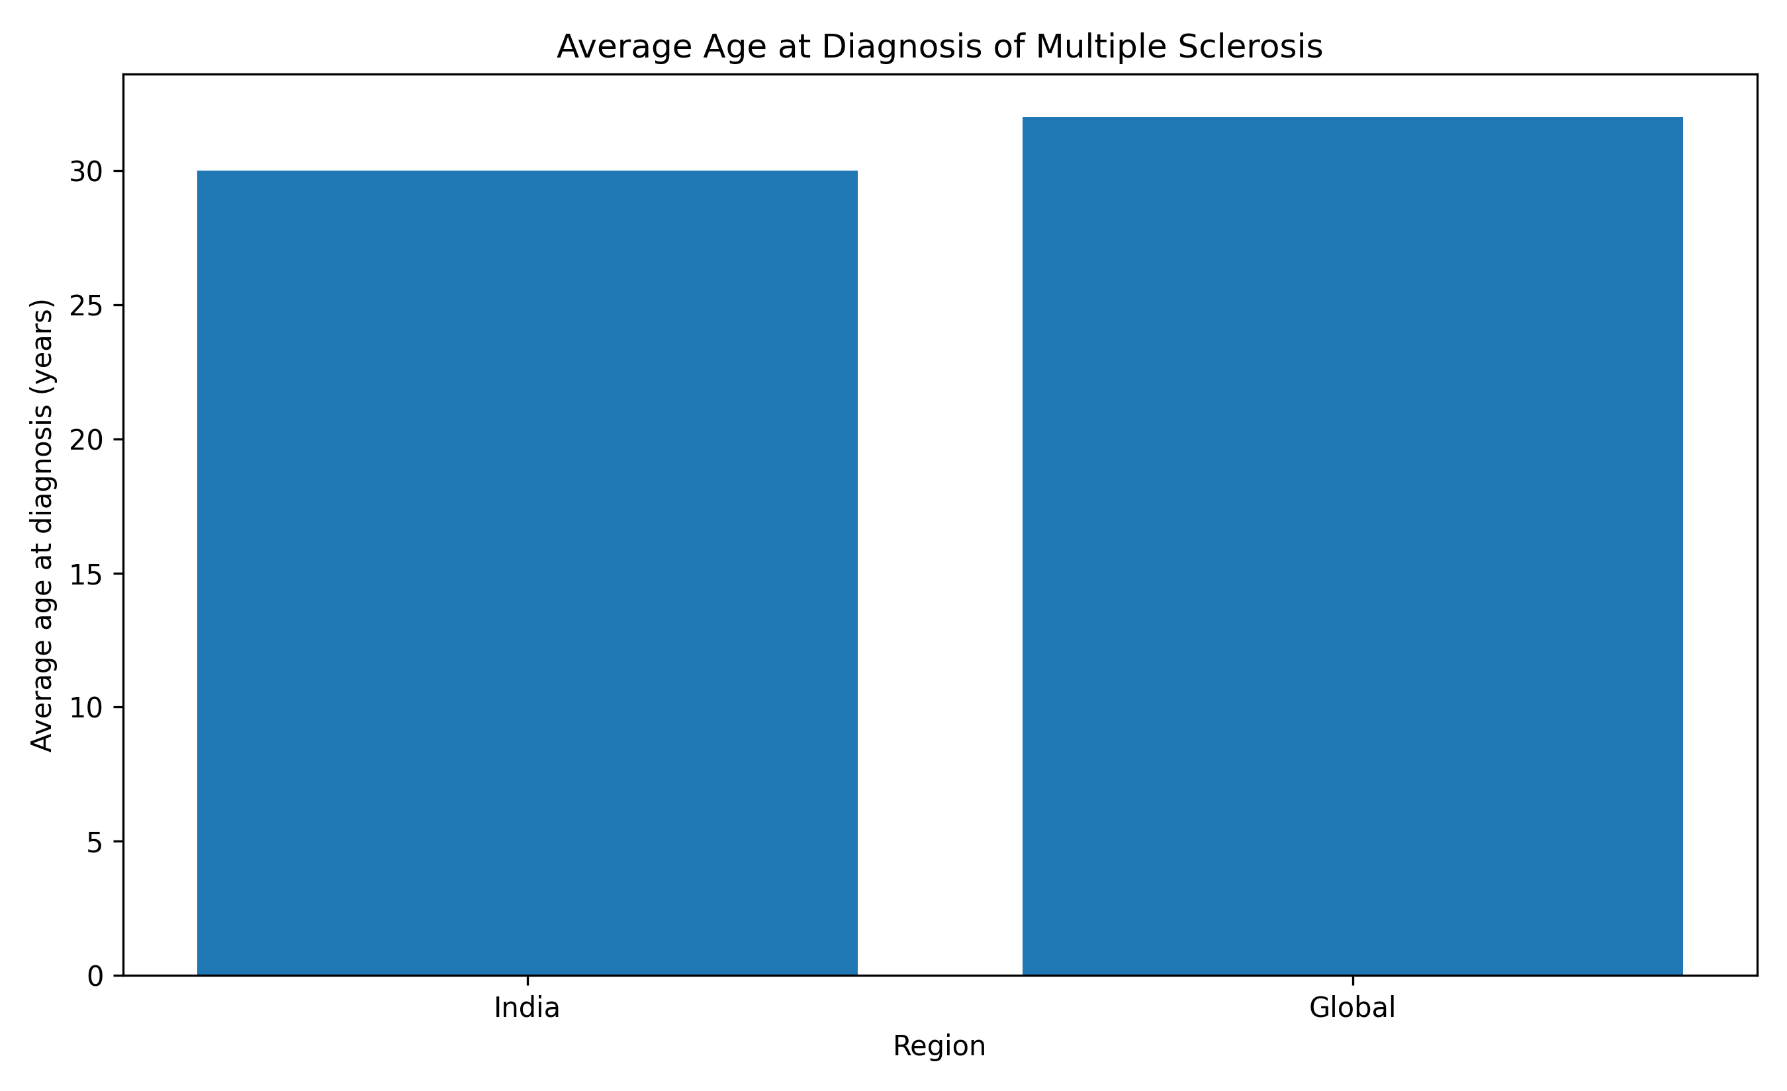
Review and Status of Research
National Status
MS is less common in India than in the West, but its prevalence is significant due to the country's massive population.
According to rough estimations, the number of people living with multiple sclerosis (MS) in India might be between 106,600 and 1,10,000.
That's roughly 7.8 cases per 100,000 people, with age-standardised prevalence rates.
Clinics report MS typically strikes young people and is slightly more common among women than men.
Sources: Indian MS studies.

Slide 6
Review and Status of Research
National Status
MS is less common in India than in the West, but its prevalence is significant due to the country's massive population.
According to rough estimations, the number of people living with multiple sclerosis (MS) in India might be between 106,600 and 1,10,000.
That's roughly 7.8 cases per 100,000 people, with age-standardised prevalence rates.
Clinics report MS typically strikes young people and is slightly more common among women than men.
Sources: Indian MS studies.

Slide 7

EXISTING SYSTEM
1. 2D CNN-Based Methods
These methods take individual MRI slices as input, feeding them through a CNN for classification.
They excel in image-based analysis and are relatively lightweight.
However, they may overlook crucial information about feature changes across consecutive slices, since each slice is treated independently.
2. 3D CNN-Based Methods
These methods take the entire MRI volume (a stack of slices) as input and process it using a 3D CNN.
A 3D CNN processes the entire MRI volume, capturing spatial relationships in all three dimensions and providing a more complete view of the brain.
This approach requires significantly more memory and computational power, often becoming a bottleneck in resource-constrained settings.

Slide 8
LITERATURE SURVEY
S.No | Title | Author | Publisher | Vol/Pg No | Year | Algorithm | Merits | Demerits
1 | Multiple sclerosis classification and segmentation in neuroimaging MRI using different machine and deep learning techniques | R. M. Thabet et al. | Springer Nature – Artificial Intelligence Review | Vol. 58, Art. 255 | 2025 | CNN, U-Net, ConvLSTM, Attention, Transformers | •Comprehensive MS MRI review • Covers major DL methods | • No new model • Generalisation and XAI remain challenges
2 | MS-Trust: A Transformer Model with Causal-Global Dual Attention for Enhanced MRI-Based Multiple Sclerosis and Myelitis Detection | Salha M. Alzahrani | Springer Nature – Complex & Intelligent Systems | Vol. 11, Art. 331 | 2025 | Causal-Global Dual Attention, Cross-Attention, SE | • Attention-based MS detection • Captures global context | • No BiLSTM slice-sequence modelling • Further XAI exploration possible

Slide 9
LITERATURE SURVEY
S.No | Title | Author | Publisher | Vol/Pg No | Year | Algorithm | Merits | Demerits
3 | MS-DASPNet: Multiple Sclerosis lesion segmentation from brain MRI using dual attention and spatial pyramid pooling with transfer learning | Shikha Jain et al. | Frontiers – Frontiers in Computational Neuroscience | Vol. 19, Art. 1713766 | 2026 | VGG-16, ASPP, Dual Attention | • Multi-scale lesion features • Uses attention | • Mainly segmentation • Limited consecutive-slice modelling
4 | A Multiple Sclerosis MRI Dataset with Tri-Mask Annotations for Lesion Segmentation | Mahdi Bashiri Bawil et al. | Springer Nature – Scientific Data | Vol. 13, Art. 867 | 2026 | T1, T2, FLAIR, Tri-Mask | • Multi-sequence MRI dataset • Detailed lesion annotations | • Mainly segmentation-oriented • No sequence-attention model

Slide 10
LITERATURE SURVEY
S.No | Title | Author | Publisher | Vol/Pg No | Year | Algorithm | Merits | Demerits
5 | Hybrid deep learning and feature optimization approach for early detection of multiple sclerosis | Nandini Anam et al. | Frontiers – Frontiers in Human Neuroscience | Vol. 19, Art. 1685580 | 2026 | VGG-16, GLCM, CLAHE, WOA, ANN | • Combines deep + handcrafted features • Feature optimisation | • No sequential slice modelling • Limited slice-level XAI
6 | Multiple Sclerosis Lesion Analysis in Brain Magnetic Resonance Images: Techniques and Clinical Applications | Yang Ma et al. | IEEE – Journal of Biomedical and Health Informatics | Vol. 26, No. 6, pp. 2680–2692 | 2022 | Statistical methods, CNNs, Deep Learning, Domain Adaptation | • Comprehensive MS MRI review. • Covers traditional and deep-learning methods. | • No new model proposed. • Mainly focuses on lesion analysis. • MRI variability remains a challenge.

Slide 11
OBJECTIVES
Main Objective
Design a deep learning framework to analyze Multiple Sclerosis from multi-sequence brain MRI scans (T1, T2, and FLAIR).
Specific Objectives
Review existing deep learning methods for MS detection and analysis from MRI data.
Prepare MRI inputs across three sequences: T1-weighted, T2-weighted, and FLAIR-weighted.
Apply preprocessing techniques to standardize and enhance MRI data.
Arrange consecutive MRI slices into a properly ordered sequence to preserve spatial continuity.
Use EfficientNet-B0 to extract spatial features from individual slices.

Slide 12
OBJECTIVES
Employ a Bidirectional Long Short-Term Memory (BiLSTM) layer to capture relationships between consecutive slices.
Integrate a slice-sequence attention mechanism to focus on the most informative slices.
Evaluate the model using subject-level 5-fold cross-validation for reliable patient-wise performance estimation.
Use Gradient-weighted Class Activation Mapping (Grad-CAM) to generate visual explanations highlighting brain regions influencing the model’s predictions.
Assess performance using standard classification metrics: accuracy, precision, recall, F1-score, and area under the receiver operating characteristic curve (AUC).

Slide 13
SDG GOALS
Our project contributes to SDG 3: Good Health and Well-Being by demonstrating how artificial intelligence can be used to analyse Multiple Sclerosis, a neurological disease affecting the central nervous system.
Our project is dedicated to Multiple Sclerosis, a chronic disease affecting the brain and spinal cord, causing long-term demyelination and leading to neurological disability.
We aim to employ computer vision and deep learning methods to achieve computer-aided diagnosis of Multiple Sclerosis using brain MRI scans.
The proposed approach is expected to enable accurate identification of MS biomarkers.
Moreover, we have implemented the Grad-CAM explanation method, which allows us to visualize MRI regions contributing to the model’s decisions, thus making MS diagnosis more interpretable.
Hence, our project promotes health and well-being by facilitating the development of artificial intelligence-based medical image analysis for healthcare practitioners and helping to fight against Multiple Sclerosis specifically.

Slide 14
METHODOLOGY
Steps | Methodology | Key Activities
1 | MRI Data Preparation | • T1, T2 and FLAIR MRI • Registration and preprocessing • Intensity normalization
2 | Slice Sequence Formation | • Ordered axial slices • Fixed-length sequence • Initially 24 consecutive slices
3 | Spatial–Sequential Feature Learning | • EfficientNet-B0 for spatial features • BiLSTM for slice-sequence learning
4 | Attention & MS Classification | • Slice-sequence attention • Important slice identification • MS prediction
5 | Explainability & Evaluation | • Grad-CAM visualization • Important region identification • Model performance evaluation

Slide 15
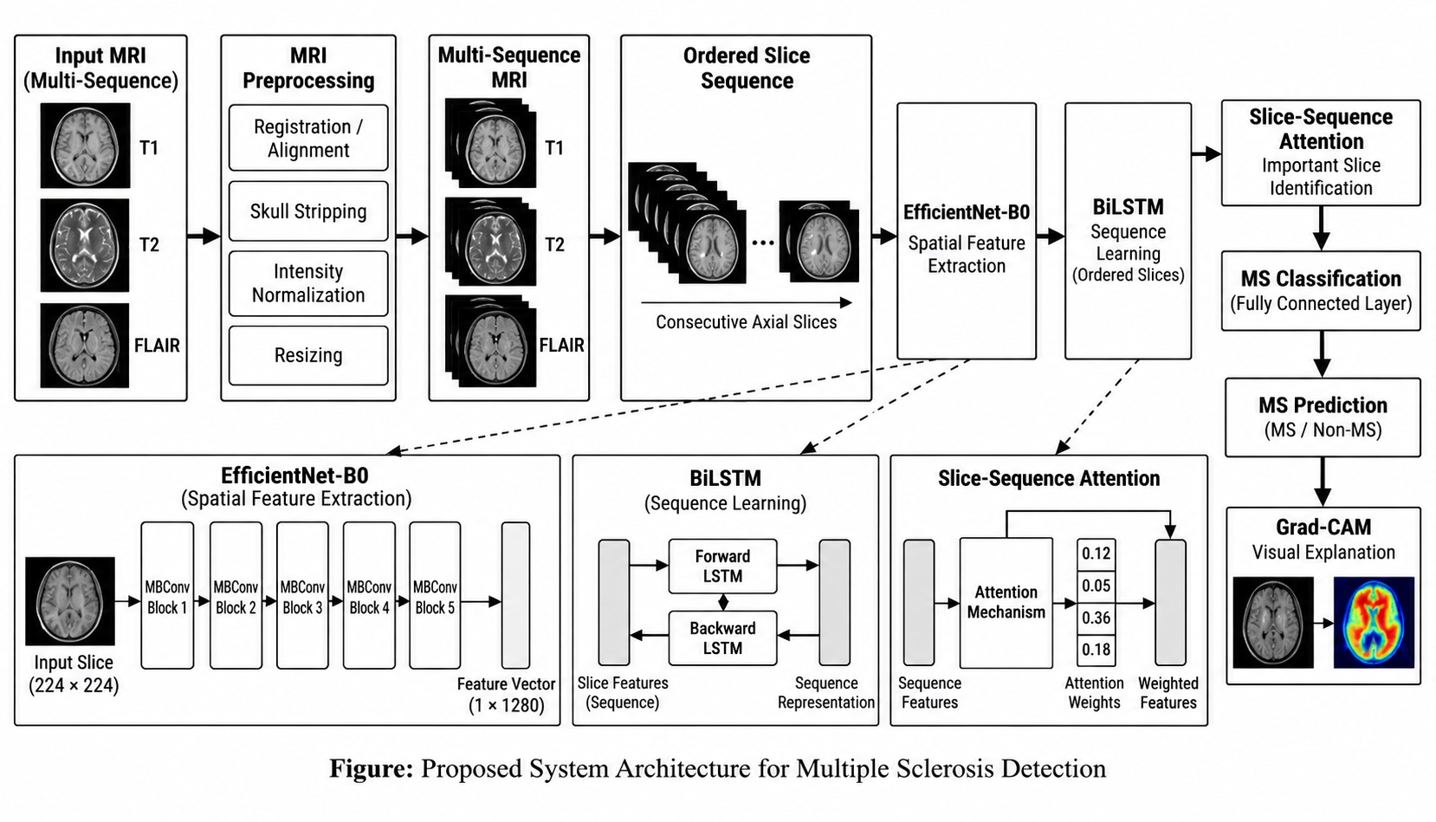
SYSTEM ARCHITECTURE

Slide 16
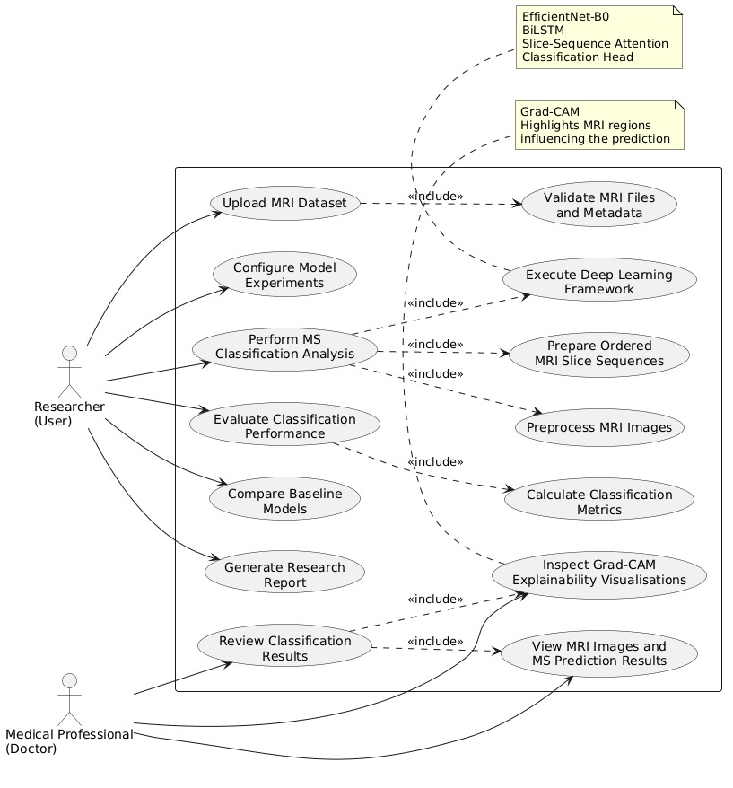
USE CASE DIAGRAM

Slide 17
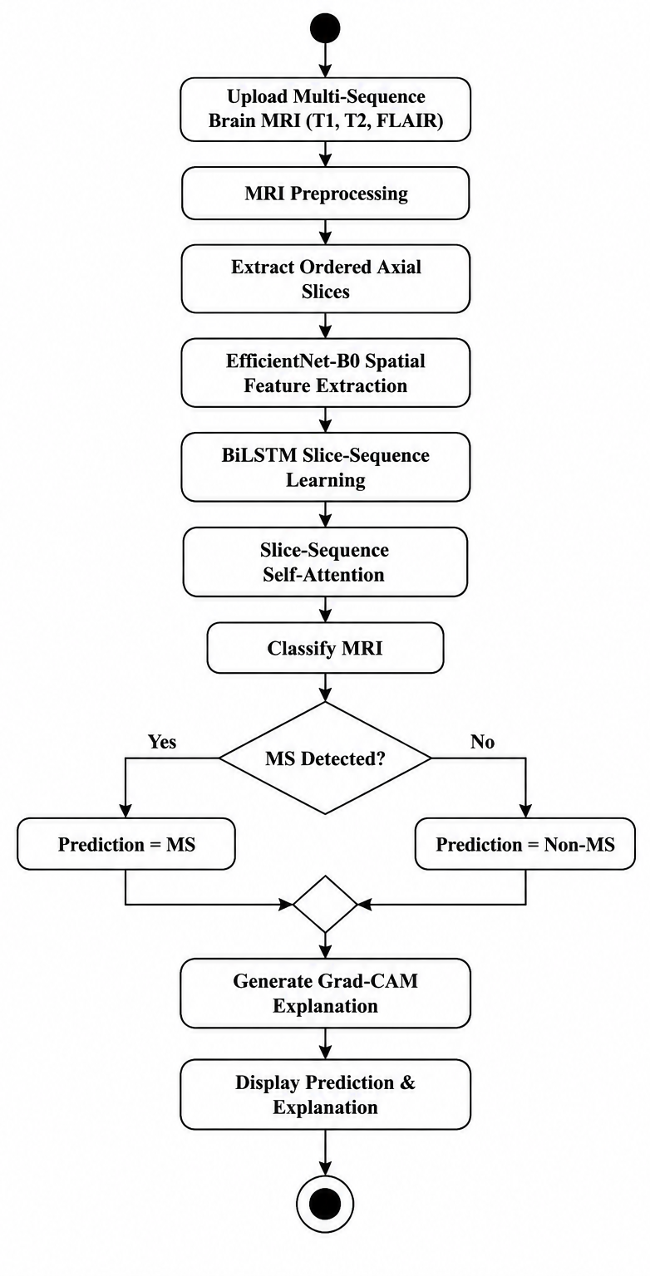
ACTIVITY DIAGRAM

Slide 18
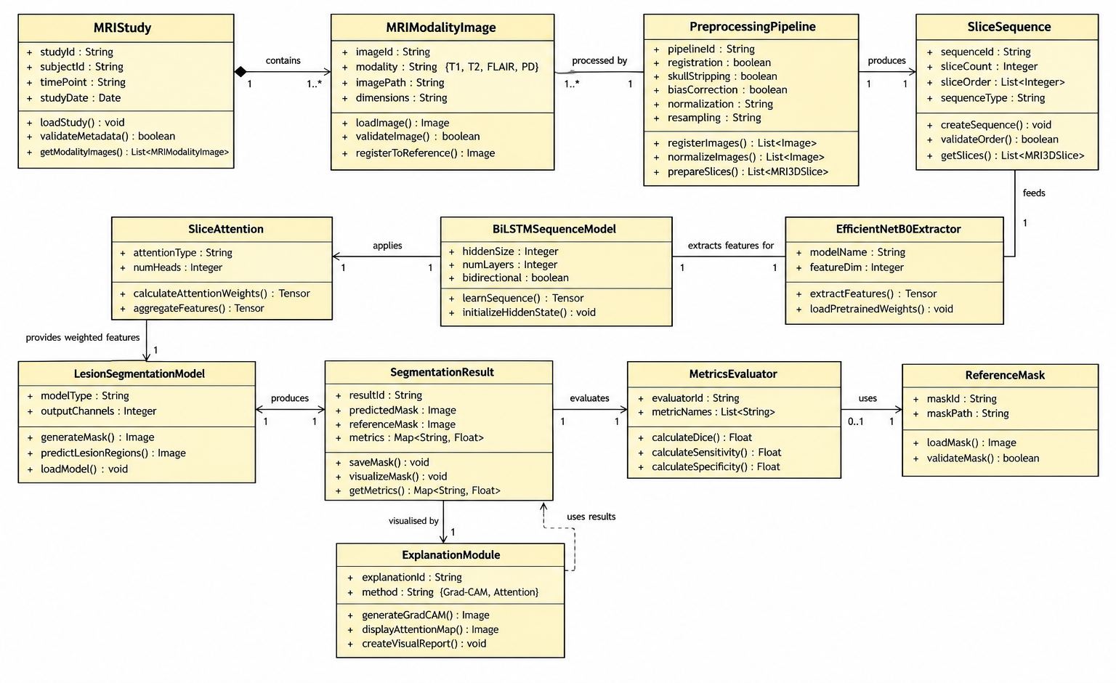
CLASS DIAGRAM

Slide 19
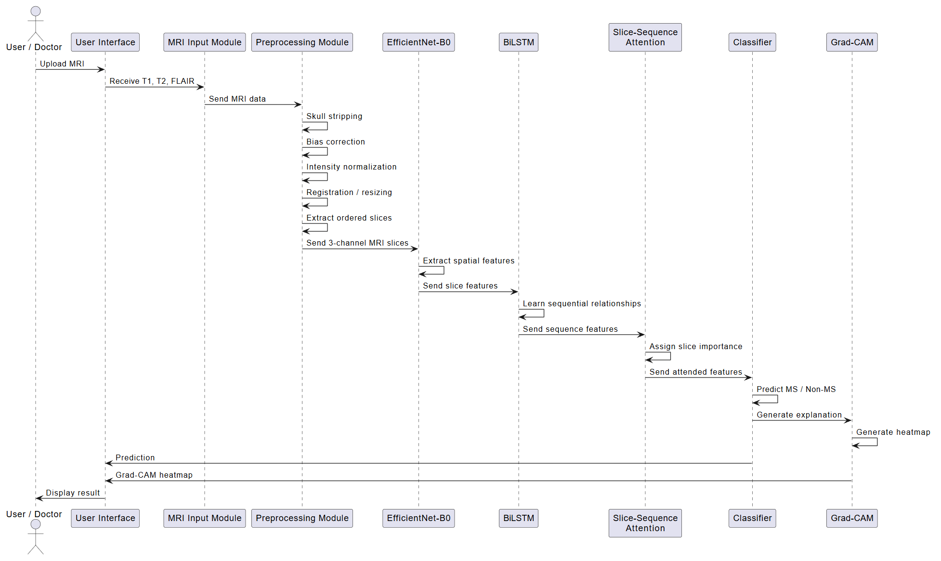
SEQUENCE DIAGRAM

Slide 20
TECHNICAL STACK
Python & PyTorch (Core Framework): The tool will be used to develop, train, and deploy the underlying deep learning models to analyze the sequences of images.
EfficientNet-B0 (Feature Extraction): The computer vision model will play the role of an encoder for multiple convolutional neural networks to extract image features.
BiLSTM & Slice-Sequence Attention: These natural language processing elements will be applied to analyze the spatial-temporal patterns of information in MRI scans.
MRI Processing Libraries: This collection of tools will be used to process and normalize MRI scans before feeding the data into a neural network.
Grad-CAM & Attention Visualisation: The research will incorporate the interpretability methods to visualize the MRI regions that contribute most significantly to the model’s final decision.

Slide 21
MODULE DESCRIPTION
Module 1 MRI loading and preprocessing: This will handle the loading of the MRI scans, including any associated metadata, as well as the necessary registrations, alignment, and normalization to prepare the data for the pipeline.
Module 2 Ordered slice-sequence preparation: This will take the preprocessed MRI scans and arrange them into an ordered sequence that will be fed into the model.
Module 3 EfficientNet-B0: This convolutional neural network (CNN) model will be used to extract spatial features from MRI images.
Module 4 BiLSTM + slice attention: A bidirectional long short-term memory (BiLSTM) network will learn the spatial-temporal relationships between ordered MRI slices, while a slice attention network will identify the relevant spatial features for the detection task.
Module 5 Lesion segmentation and explainability: The final head of the model will predict lesions using segmentation masks, while grad-CAM and slice-attention highlights will provide visual explanations of the model’s diagnostic results.

Slide 22
ALGORITHM
Algorithm: Patient-wise MRI Sequence Prediction and Report Generation
Input: Processed MRI patient files, trained model checkpoint, sequence length (L=5)
Output: Patient-wise MRI visualizations and CSV prediction report
Pseudocode
Start.
Load and sort the processed MRI patient files.
Generate five-slice sequences using the MRI dataset loader.
Group the sequences according to patient ID.
Load the trained model checkpoint and set the model to evaluation mode.
For each patient from 1 to 60:
a. If no sequences are available, skip the patient.
b. Select a lesion-positive sequence if available; otherwise, select the first sequence.
c. Convert the selected sequence into a normalized input tensor.
d. Perform model inference to obtain prediction logits and temporal attention weights.
e. Apply the sigmoid function and threshold of 0.5 to determine the predicted sequence label.
f. Load the corresponding lesion masks and select a lesion-containing slice for visualization, if available.
g. Generate MRI channel images, lesion-mask overlay, temporal attention plot, and prediction details.
h. Save the patient visualization as a PNG file.
i. Store the prediction, reference label, probability, and attention weights.
Export all collected prediction results to a CSV file.
Stop

Slide 23
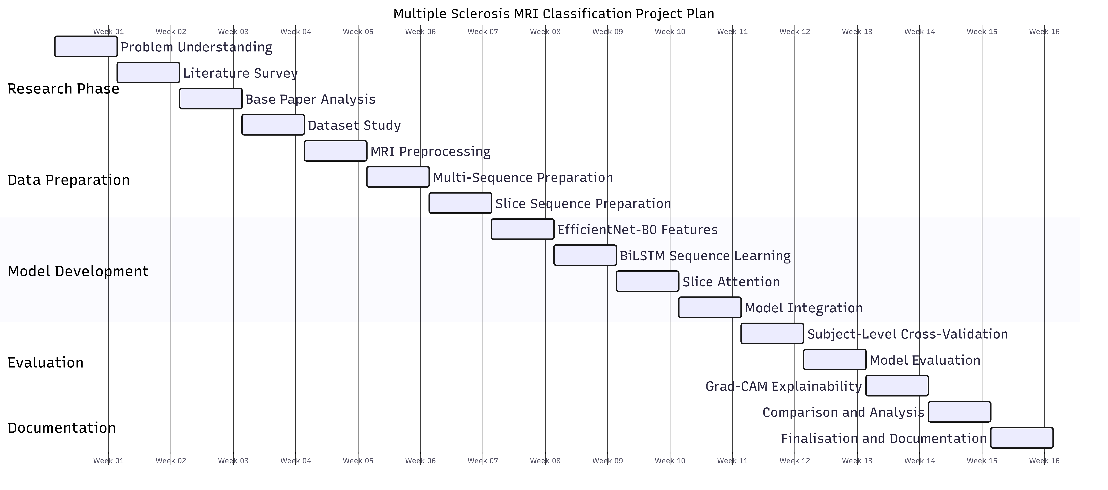
WORK PLAN

Slide 24
REFERENCE
[1] R. M. Thabet, H. A. Shedeed, M. Al-Berry, and D. Khattab, “Multiple sclerosis classification and segmentation in neuroimaging MRI using different machine and deep learning techniques: A review,” Artificial Intelligence Review, vol. 58, Art. 255, 2025.
[2] S. M. Alzahrani, “MS-Trust: A transformer model with causal-global dual attention for enhanced MRI-based multiple sclerosis and myelitis detection,” Complex & Intelligent Systems, vol. 11, Art. 331, 2025.
[3] S. Jain, N. Rajpal, and P. K. Soni, “MS-DASPNet: Multiple Sclerosis lesion segmentation from brain MRI using dual attention and spatial pyramid pooling with transfer learning,” Frontiers in Computational Neuroscience, 2026.
[4] M. B. Bawil, M. Shamsi, A. Ghalehasadi, et al., “A Multiple Sclerosis MRI Dataset with Tri-Mask Annotations for Lesion Segmentation,” Scientific Data, vol. 13, Art. 867, 2026.
[5] N. Anam, S. Basha, and C. L. Chowdhary, “Hybrid deep learning and feature optimization approach for early detection of multiple sclerosis,” Frontiers in Human Neuroscience, vol. 19, Art. 1685580, 2026.
[6] Y. Ma, C. Zhang, M. Cabezas, Y. Song, Z. Tang, D. Liu, W. Cai, M. Barnett, and C. Wang, “Multiple Sclerosis Lesion Analysis in Brain Magnetic Resonance Images: Techniques and Clinical Applications,” IEEE Journal of Biomedical and Health Informatics, vol. 26, no. 6, pp. 2680–2692, 2022.
[7] N. Gessert, J. Krüger, R. Opfer, A.-C. Ostwaldt, P. Manogaran, H. H. Kitzler, S. Schippling, and A. Schlaefer, “Multiple sclerosis lesion activity segmentation with attention-guided two-path CNNs,” Computerized Medical Imaging and Graphics, vol. 84, Art. 101772, 2020.

Slide 25
THANK YOU

